Slide 1
Powerpoint resource:
for talks or sermons

Slide 2
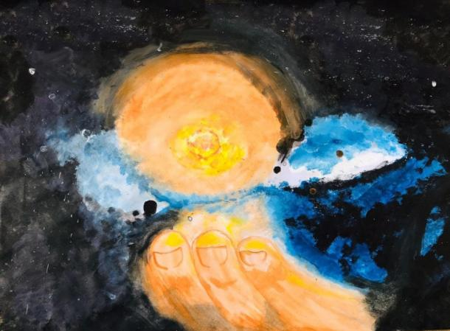
Living and learning in God’s creation:
1) Creation from chaos
2) Care for the world: our home
3) Children need good homes
We live in God’s creation: he has made it our wonderful home to look after: Genesis 1:1 – 2:2
Artwork by: Vansh (13) India - day 1;

Slide 3
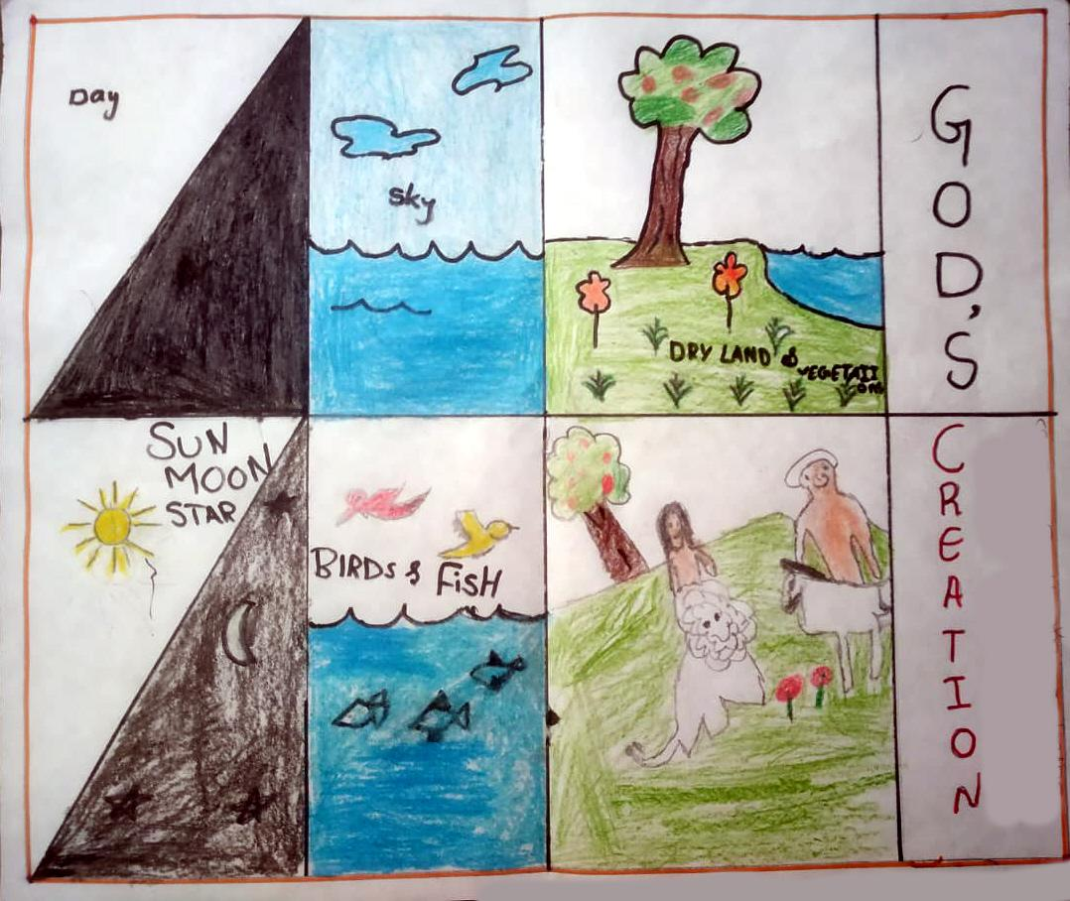
Creation from chaos
Which are these 6 days?
Which day is missing?
What happened on that day?
How is God bringing order from chaos in our lives today?
Artwork by: Harika (13) India

Slide 4
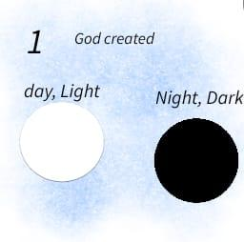
Creation day 1
Thank you, God, for the light. Thank you God for different kinds of lights at night time.
Are you a light for Jesus? To family. To friends.
Artwork by: Evie (12) UK

Slide 5
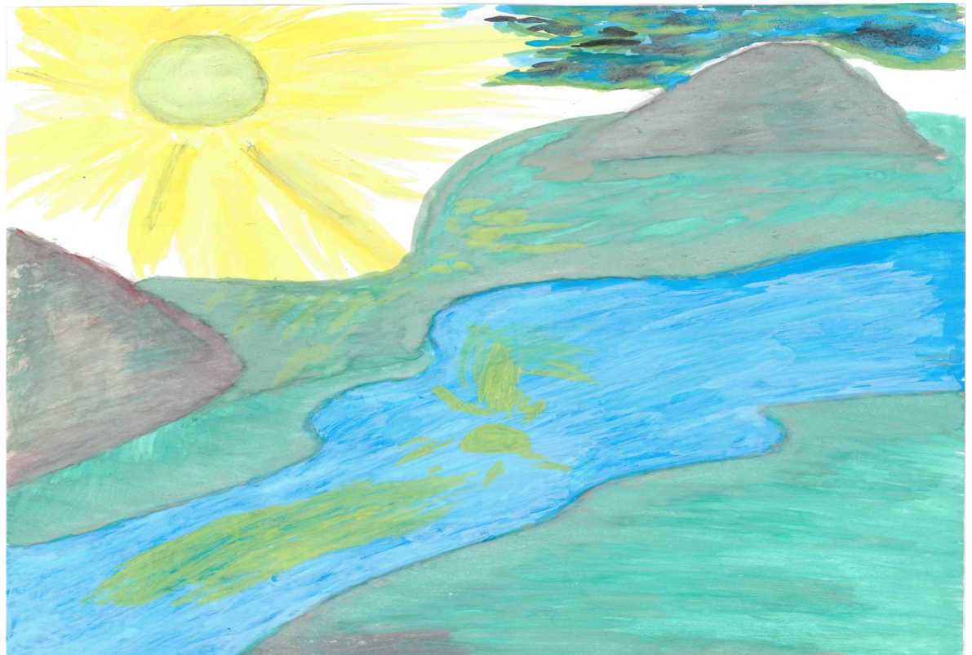
Creation day 2
Sea and sky: different types of weather. The beauty of seasons.
Thank you God for the gift of rain that waters the earth.
Please send rain to those who need it most Almighty Creator God, you are so powerful. Please send drier and stable weather for those with too much rain.
How can I refresh those I live with ?
Artwork by: Musinguzi (6), Uganda

Slide 6
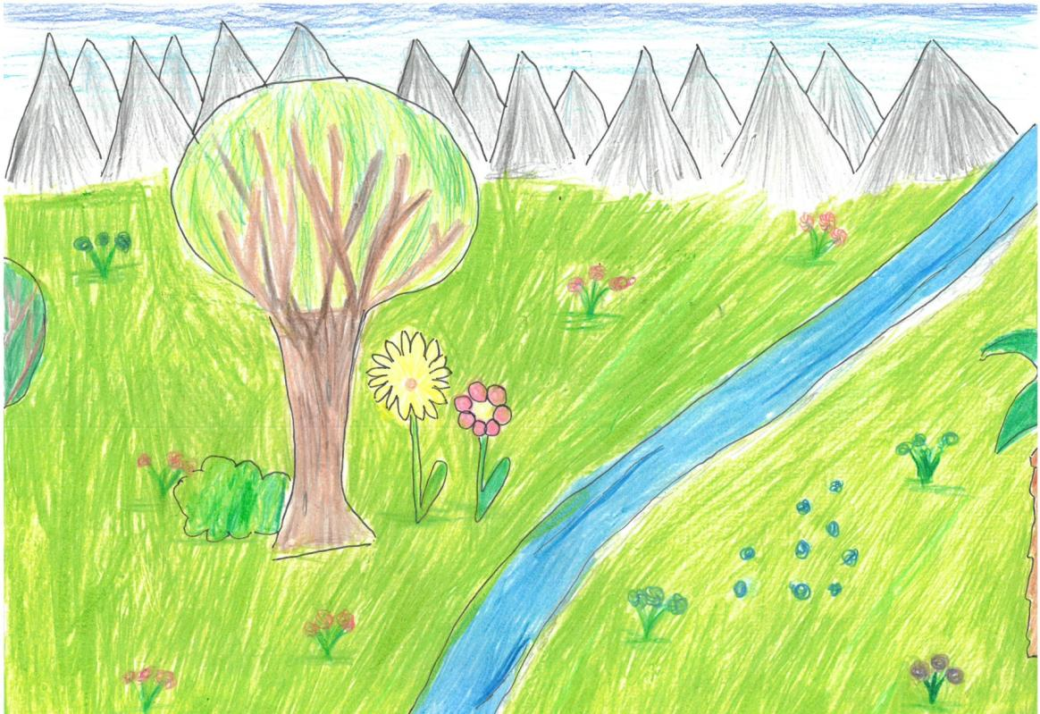
Creation day 3
Land formed with trees, fruit and vegetation
Thank you God for hills and valleys to live in.
for fruit and vegetables to eat.
Artwork by: Annalie (10) Germany

Slide 7
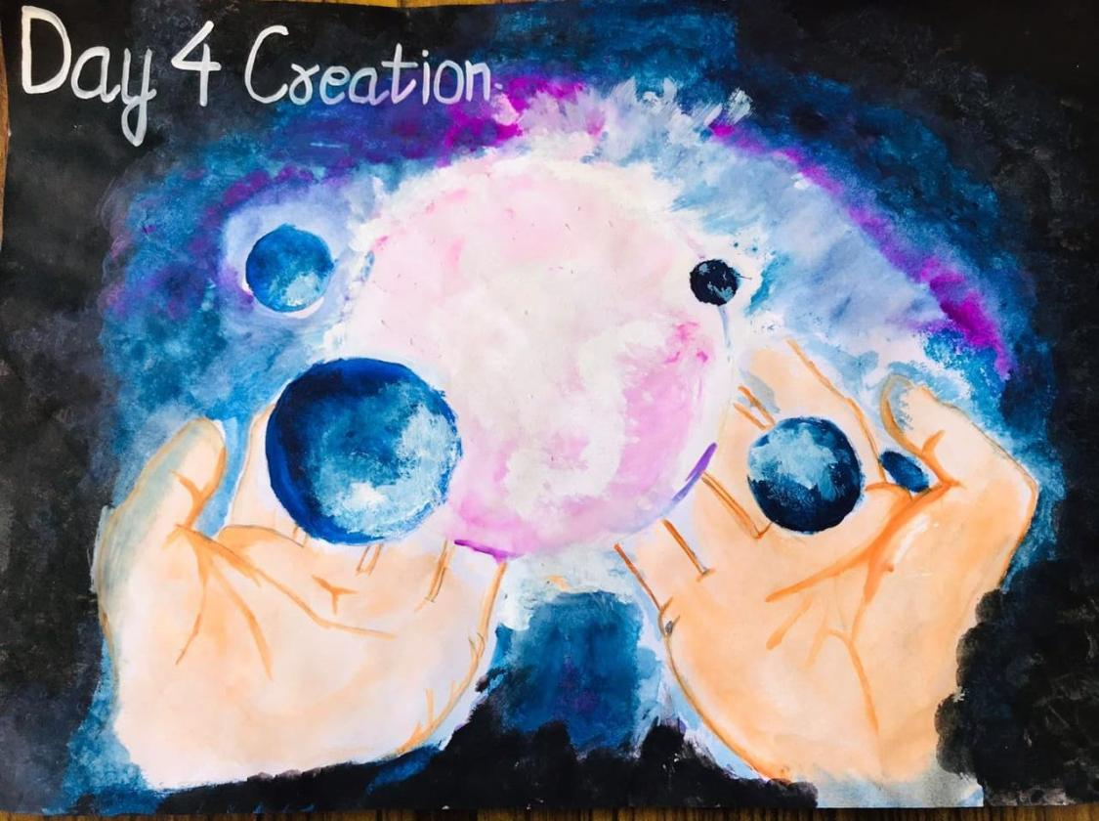
Creation day 4
Day, night. Sun, moon and stars
Thank you God For sunlight and seasons.
for gravity that holds the universe together
Hold me in the palm of your hands as you promised.
Artwork by: Uday (19) India

Slide 8
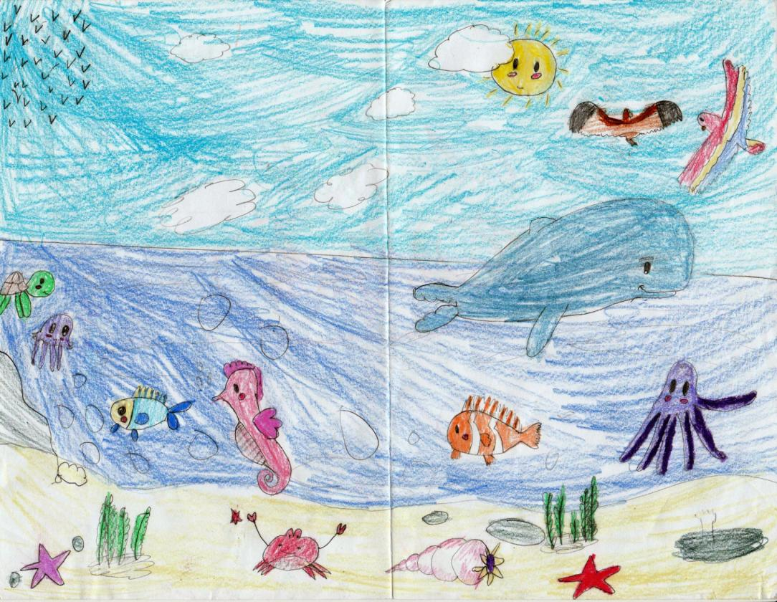
Creation day 5
Fish and birds
Praise the beauty of fish and birds,
the finally balanced systems in which they live.
God’s gift as food.
Artwork by: Isabel (9) Cuba

Slide 9
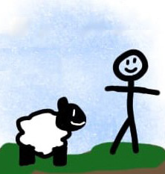
Creation day 6
All land creatures. Domestic animals. Mankind
You open your hand and satisfy the desires of every living thing.
The Lord is righteous in all his ways and faithful in all he does. Ps 145:16,17
Artwork by: Evie (12) UK

Slide 10
Creation day 7
A day of rest
Thank you for Sundays.
How are you making day 7 special?

Slide 11
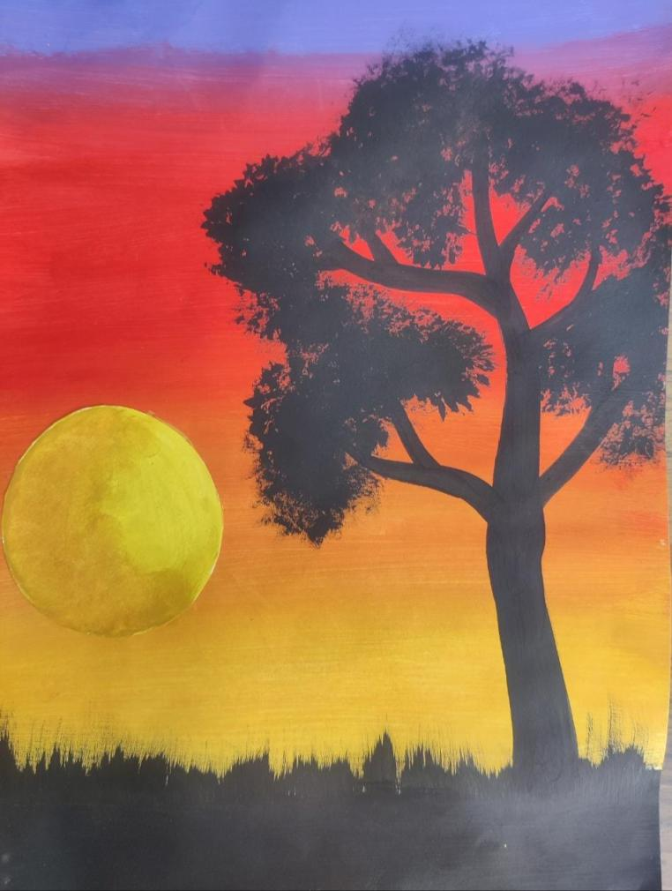
2) Care for the world: our home
Renewable sources for electricity
Wise use of water: dams, irrigation, pumps and pipes
Care of soils for the future. Limit cutting down of forests.
Reduce man’s influence on climate
Avoid over fishing. Sustainable farming systems.
Balance human population needs and wildlife
Good routines and balance of work, rest and play.
Artwork by: Jatin (16) India

Slide 12
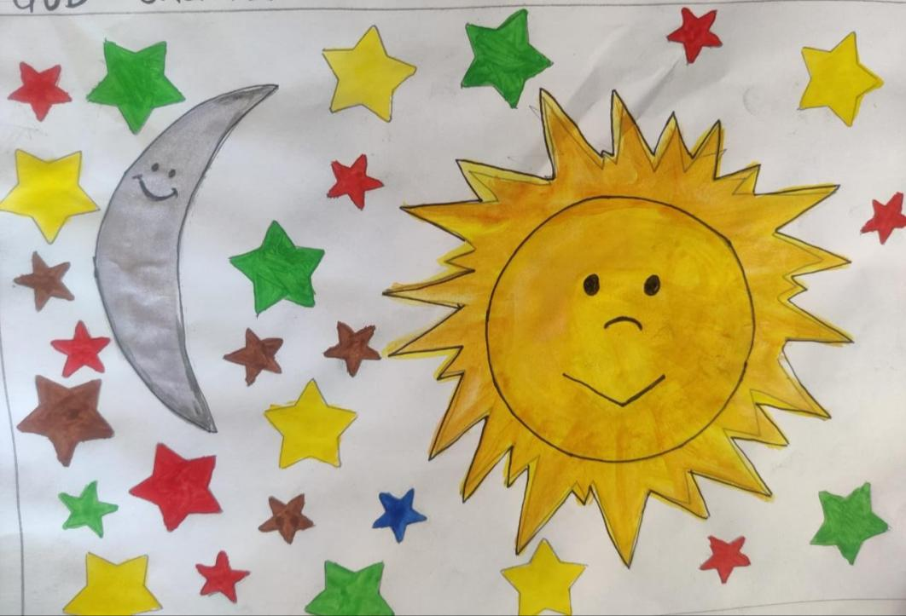
3) Children need a good home
Jesus to shine light where the darkness of bad behaviour is a threat.
Clean, unpolluted water to drink for all
Adequate fresh fruit and vegetables for growing children.
Help for children and families in natural disasters
Enough protein in diets. Less disease from animals to humans
Marriages to be filled with love for children
Enjoy regular special days in family going to green spaces.
Artwork by: Jeet (11) India

Slide 13
1) Creation from chaos
2) Care for the world: our home
3) Children need good homes
‘The Lord watches over all who love him, but all the wicked he will destroy. My mouth will speak in praise of the Lord. Let every creature praise his holy name for ever and ever.’ Psalm 145 20–21

