Slide 1
Powerpoint resource:
for talks or sermons

Slide 2
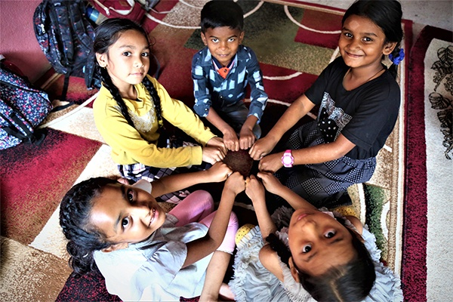
Start by clicking the link to watch the animation
Healing of the blind man in John chapter 9
What are the works of God?
Why do you doubt?
Who is Jesus?
What is faith?
"While I am in the world, I am the light of the world.“ John 9 v 5

Slide 3
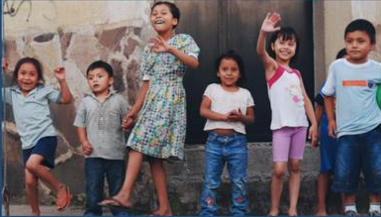
Works of God - John 9:1-12
Bad things happening give
God’s power a place to work
What can we do to draw
God’s power out? Pray?
And what else?
What changes in family, friend's family, school or locality can we pray for?
The blind man had to trust Jesus and do his part (wash in the pool).
Are we ready to do our part in God’s miracles?
While I am in the world,
I am the light of the world.’
John 9:5
Notes:
Prepare your own notes from the passage. Consider the issues children and teenagers face in your community and answer the questions posed in the slides as your own talk, fit for the age group and their local circumstances

Slide 4
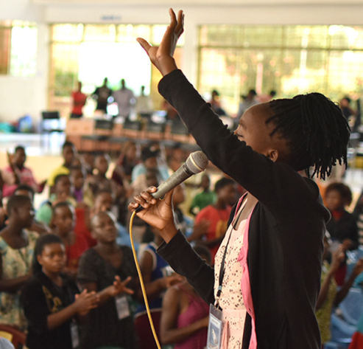
Why do you doubt? John 9:13-23
The blind man has his sight restored.
His neighbours doubt it’s him.
The Pharisees doubt he was blind from birth.
What doubts do we have?
When do we give up on God to do things for us?
Why do we doubt?
What is a miracle?
Share some big and small miracles.
Discuss where do we need a miracle now?
(family, school, community)
"He put mud on my eyes," the man
replied, "and I washed, and now I see.“ John 9:15b

Slide 5
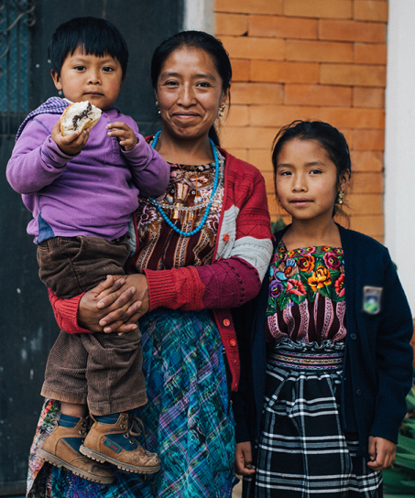
Who is Jesus? John 9:24-34
The blind man is summoned a second time
to be questioned by the Pharisees. The man
gives his own testimony:
“I was blind but now I see.”
Are young people still divided about who Jesus is?
How can we and children help them understand?
What things are important to know about Jesus?
The blind man listened to Jesus and did what he said
(washed in Siloam).
How can we listen better in prayer?
Nobody has ever heard of opening
the eyes of a man born blind. If this man
were not from God, he could do nothing.’
John 9:32-33

Slide 6
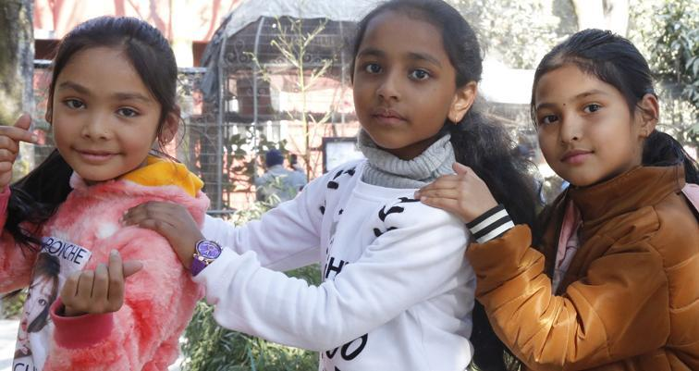
What is faith? John 9:35-41
The blind man, now healed, is insulted
and thrown out of the synagogue.
Yet Jesus comes to find him and wants
to know if he, “believes in the Son of Man.”
He had not seen Jesus before.
Can we believe even if we do not see Jesus?
Do we have that faith?
Imagine how it must have been when the man could see for the first time.
Is that not like us when we accept Jesus as the Son of God?
Do we need more faith? Remember previous blessings.
Can Jesus change our homes, our streets, our schools?
YES!
Then the man said, ‘Lord, I believe,’
and he worshipped him.
John 9:38

Slide 7
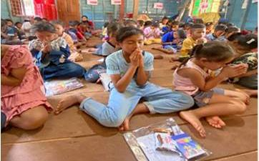
Close in prayer: 7 points
Peace and love in my home and family.
Enough food, clean drinking water,
clothes and health care.
Peace and an end to violence in my streets.
For education: school access + good, kind, loving teachers.
Protection and safety from bullies and tricksters.
Changed +ve attitudes of adults towards children
More churches work together in our city
to improve the lives of children.

